Slide 1
Software project

Slide 2
Team Member : rushi hansora – it042 vraj donga – it028

Slide 3

Online shopping ~ Extraordinary Savings on Everything

Slide 4
agenda
Introduction
Problems
Solution
Benefits
Preview
More About Project

Slide 5
introduction
Online Shopping is a form of e-commerce whereby consumers directly buy goods or services from a seller over the internet without any intermediary service.

Slide 6
problems
Limited choices
High fixed prices
Lake of review
Limited payment Mode

Slide 7
solution
Online Shopping

Slide 8
benifits
Wide Selection
Cost Effective
Review & Ratings
24/7 Availability
Best Offers & Discounts
Doorstep Delivery
Easy To Payment
Time Saving
We can get lots of option of our product in online shopping
We can buy product by paying reasonable price
We also can get reviews & ratings of product which we want to buy
There is no any type of holiday in online shopping, It is open for 365 days
We can get best offers & discounts on festivals & other days too
We can get delivery of our product at our door by order at online shopping
We can pay the bill by various method like upi , cash on delivery , card etc.
Online shopping saves time because we don’t need to go market for buy product

Slide 9
Used languages in this website
HTML CSS JAVASCRIPT

Slide 10

html
HTML stands for HyperText Markup Language. It is the standard markup language for creating web pages and web applications.

Slide 11
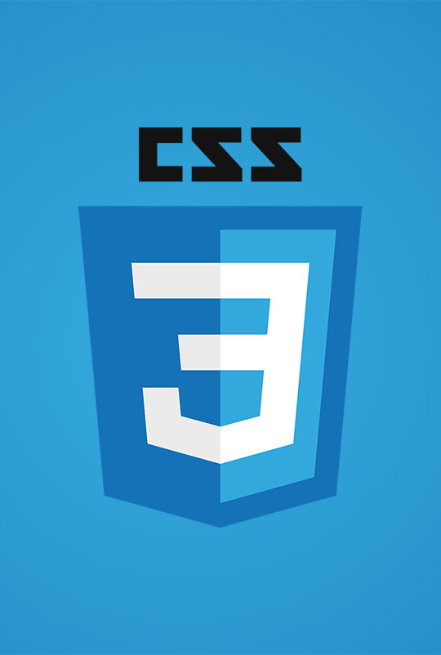
css
CSS stands for Cascading Style Sheets. It describes how HTML elements are to be displayed on screen, paper, or in other media.'

Slide 12

javascript
JavaScript is a programming language that enables interactive web pages. It is used for creating dynamic and interactive user experiences.

Slide 13


Slide 14

Product category
Clothes
Jeans
Shirt
T-shirt
Perfume
Shoes
Watch

Slide 15




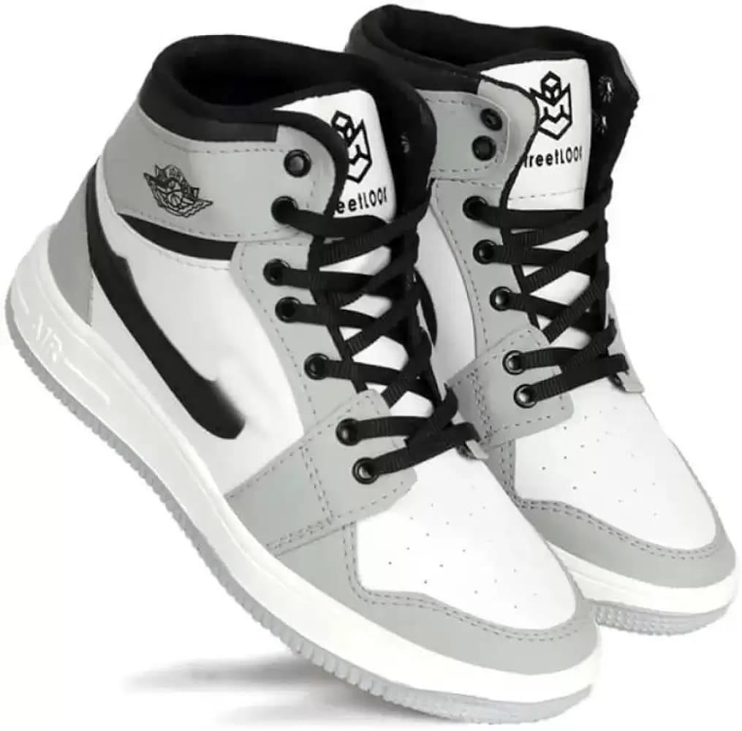
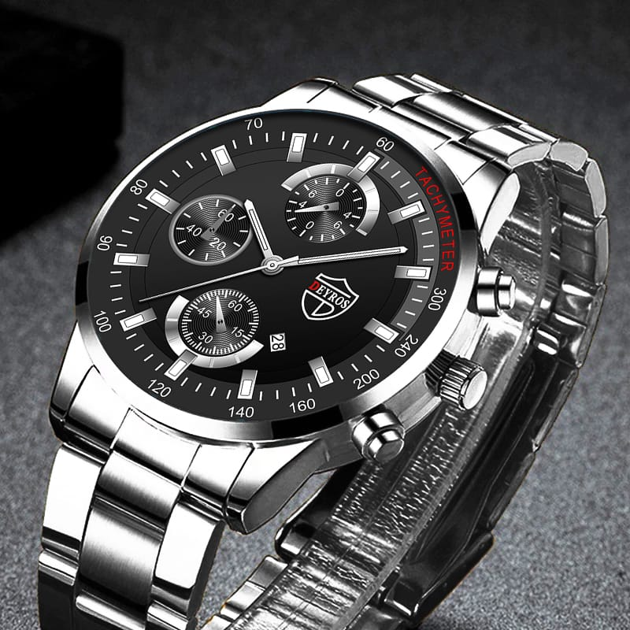

Slide 16

features
Easy To Use
User Friendly Interface

Slide 17
Thank You

